Slide 1
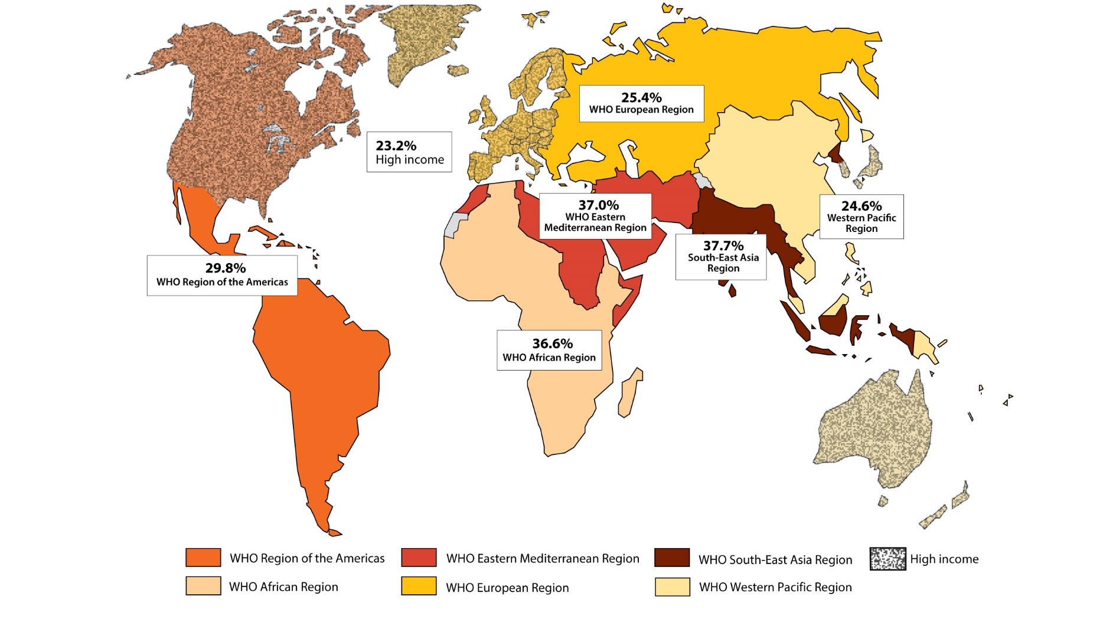
Globally 1 in 3 women will experience intimate partner or non-partner sexual violence

Slide 2
Impact of violence
Large body of research documenting the multiple negative impacts on women, their children, and society more broadly
Intimate partner violence also impacts considerably on women’s emotional and social well-being
Key social and structural driver that undermine women’s efforts to avoid HIV and/or access care and treatment services

Slide 3
Women who experience violence are at greater risk of HIV acquisition
Increased
susceptibility
Perpetrator at higher
risk of HIV
Gender power
imbalance
Trauma and lacerations
Lower T-Celll function among women who experience chronic abuse
Clustering of behaviours, with men who are violent also more likely to have concurrent sexual partners and/or engage in commercial sex
Fear of and use of violence reduces women’s ability to negotiate sex or preventive method
HIV & other STI
Notes:
3

Slide 4
Violence could undermine UNAIDS 90-90-90 targets
Limiting access to care and treatment services
Reducing adherence and viral control

